Slide 1
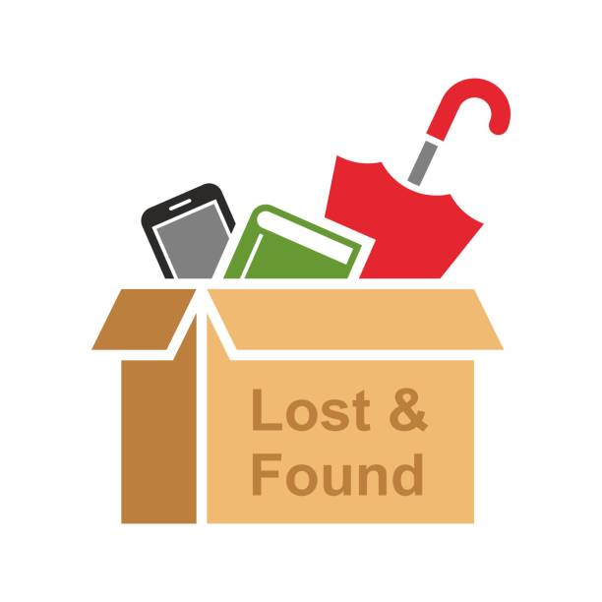
LOST AND FOUND HUB

Slide 2
INTRODUCTION
The Lost and Found Hub is an online platform designed to help individuals easily report, search, and recover lost items. In today’s fast-paced world, losing personal belongings is common, and retrieving them can often be a stressful and time-consuming process. This website serves as a centralized hub where users can post details about lost or found items, including descriptions, locations, and contact information, making it easier for people to reconnect with their belongings. By providing a user-friendly interface and efficient search functionality, the Lost and Found Hub aims to reduce the challenges associated with lost items, promote community assistance, and ensure that valuable or important possessions are returned to their rightful owners promptly.

Slide 3
PROBLEM STATEMENT
In many communities, people frequently lose personal belongings such as wallets, mobile phones, documents, ID cards, keys, and bags in public or shared spaces. Although some honest individuals find these items, there is no common, reliable, and organized platform to help connect the finder with the rightful owner. As a result, many lost items are never returned, leading to inconvenience, financial loss, and stress for individuals. Existing informal methods like social media posts or word-of-mouth are inefficient, unstructured, and limited in reach. Hence, there is a need for a community-based digital system that enables people to easily post, search, and recover lost and found items in a safe and effective manner.

Slide 4
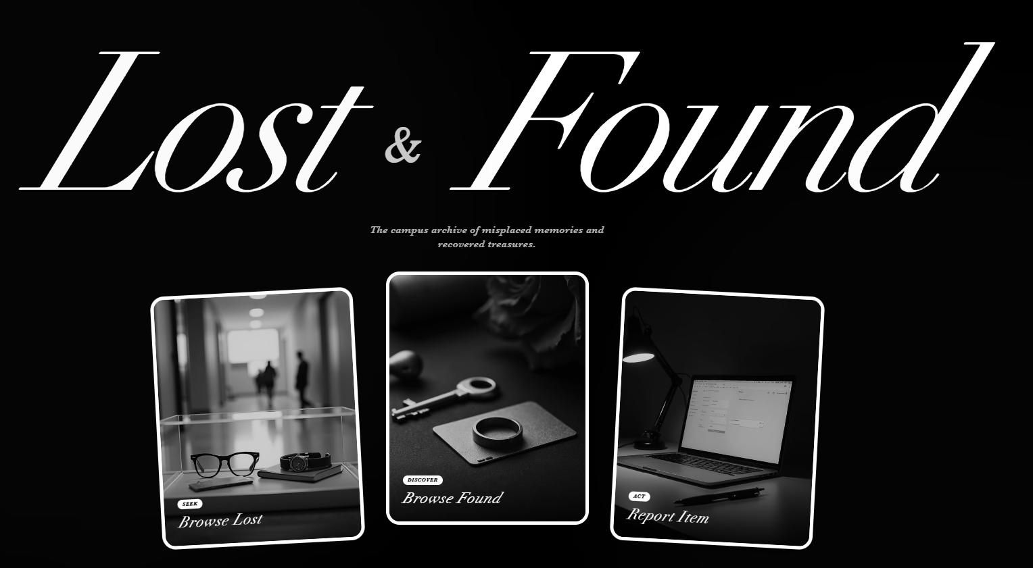

Slide 5
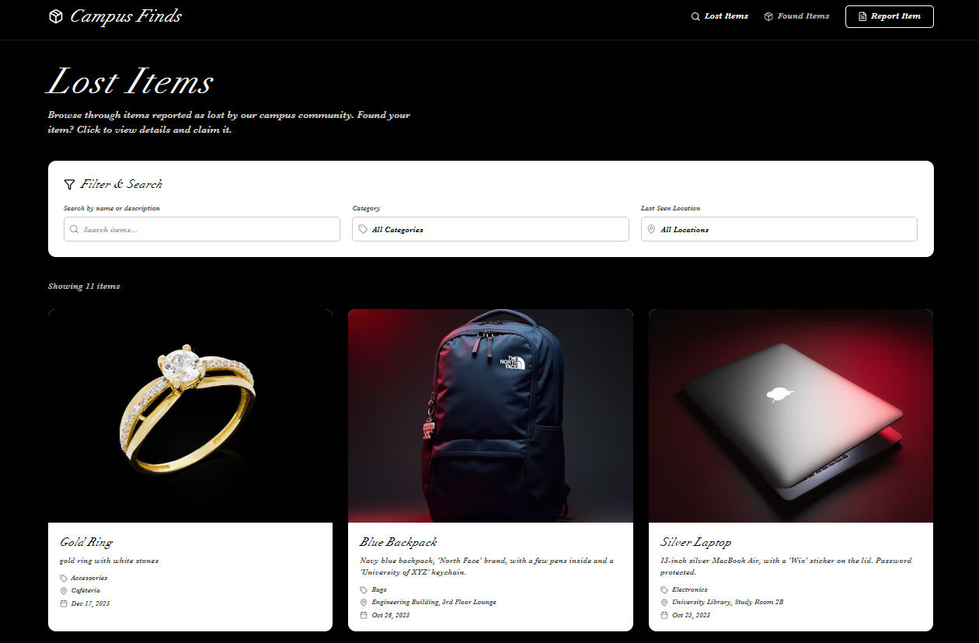

Slide 6
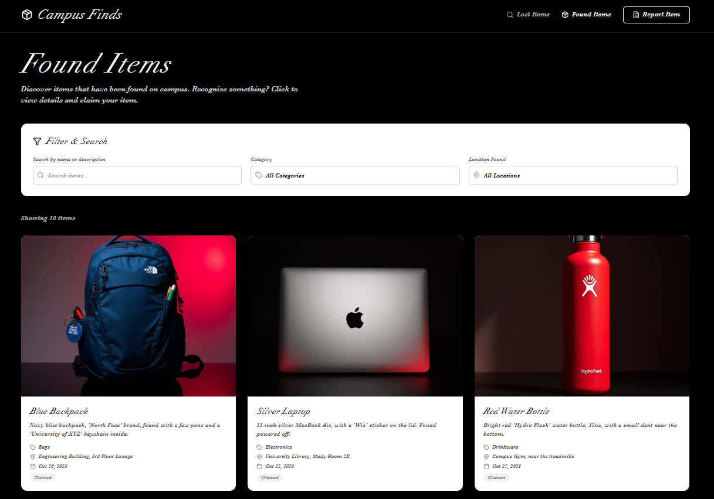

Slide 7
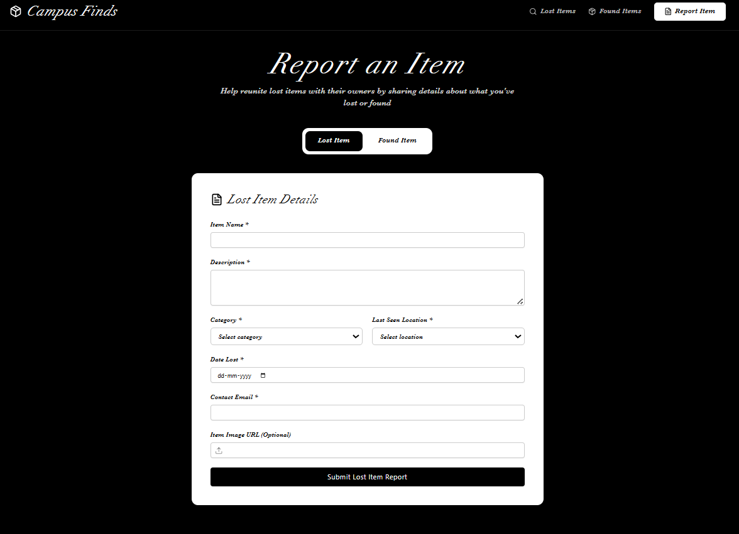

Slide 8
FUTURE OUTCOMES
Faster recovery of lost items in the community.
Reduced stress and time spent searching for belongings.
Increased community trust and cooperation.
Automated notifications for matching lost and found items.
Potential integration with local authorities for valuable items.
Adoption by schools, workplaces, and public spaces to minimize loss.
Creation of a culture of mutual responsibility and support.
Improved community engagement and safety.

Slide 9
THANK YOU

